Slide 1

Geometry
Unit 8, Lesson 1 Proving Properties of Parallelograms Volume 2, pg. 7

Slide 2


Benchmarks
MA.912.GR.1.4
Prove relationships and theorems about parallelograms. Solve mathematical and real-world problems involving postulates, relationships, and theorems of parallelograms.
MA.912.LT.4.10
Judge the validity of arguments and give counterexamples to disprove statements.
volume 2, pg. 7

Slide 3
Integrated Mathematical Thinking and Reasoning Standards
MA.K12.MTR.1.1 Actively participate in effortful learning both individually and collectively.
MA.K12.MTR.2.1 Demonstrate understanding by representing problems in multiple ways.
MA.K12.MTR.4.1 Engage in discussions that reflect on the mathematical thinking of self and others.
MA.K12.MTR.5.1 Use patterns and structure to help understand and connect mathematical concepts.
MA.K12.MTR.6.1 Assess the reasonableness of solutions.
volume 2, pg. 7

Slide 4

Learning Targets
I can define a parallelogram.
I can prove opposite sides and opposite angles of a parallelogram are congruent.
I can prove consecutive angles of a parallelogram are supplementary.
I can prove diagonals of a parallelogram bisect each other.
volume 2, pg. 7

Slide 5

Warm-Up
volume 2, pg. 7

Slide 6
8.1.1 Warm-Up: Cartographer
Dave Imus is a cartographer whose maps have won many awards. Dave sees the world through understanding places. Dave’s maps are considered art.
Have you ever used a paper map?
Since you can’t put everything on a map, what three places do you think should be on the map of Florida?
volume 2, pg. 7

Slide 7

Collaboration
volume 2, pg. 8

Slide 8

8.1.2 Collaboration: Parallel Lines and Four-Sided Figures
On a piece of patty paper, draw one set of parallel lines. Overlap your patty paper with a partner’s parallel lines to create an enclosed figure. Each partner should trace the enclosed shape onto a new piece of patty paper.
Classify the enclosed shape.
Justify your classification.
volume 2, pg. 8

Slide 9
Ask two classmates how they classified the figure they created. Record their classification and write your summary of their justification. You are the only person who should write in the first two columns of the table. Have the person initial next to your summary stating that your summary was correct.
Classification | My Summary of Their Justification | Initials
volume 2, pg. 8

Slide 10

Exploration
volume 2, pg. 8

Slide 11


8.1.3 Exploration: Properties of Parallelograms
A quadrilateral containing two pairs of parallel sides is a parallelogram. A member of the following shape classes: polygons, quadrilaterals, trapezoids. Sub-classes include rectangles, rhombi, and squares.
Using a ruler, measure the pairs of opposite sides in each parallelogram you and your partner created.
What do you notice?
Make a conjecture about the measures of opposite sides of a parallelogram.
volume 2, pg. 8

Slide 12
Using a ruler, draw the diagonals of one of the parallelograms.
Determine the lengths of each diagonal.
Mark the point where the two diagonals intersect.
volume 2, pg. 8

Slide 13
What do you notice about the point of intersection and its relationship to each diagonal?
d. Repeat the same steps to draw and measure the diagonals in your second parallelogram.
Make a conjecture about the diagonals of a parallelogram.
volume 2, pg. 9

Slide 14
Using a protractor, measure the pairs of opposite interior angles of your parallelograms.
What do you notice?
Make a conjecture about the measures of opposite angles of a parallelogram.
Make a conjecture about the measures of consecutive angles of a parallelogram.
volume 2, pg. 9

Slide 15
Based on your conjectures, select all of the statements about a parallelogram that are true.
A parallelogram has only one set of opposite parallel sides.
A parallelogram has two sets of opposite parallel sides.
A parallelogram has only one set of opposite congruent sides.
A parallelogram has two sets of opposite congruent sides.
Consecutive angles of a parallelogram are congruent.
Consecutive angles of a parallelogram are supplementary.
Opposite angles of a parallelogram are congruent.
Opposite angles of a parallelogram are supplementary.
Diagonals of a parallelogram bisect each other.
volume 2, pg. 9

Slide 16
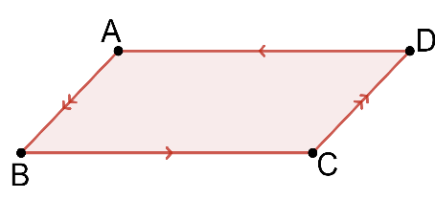
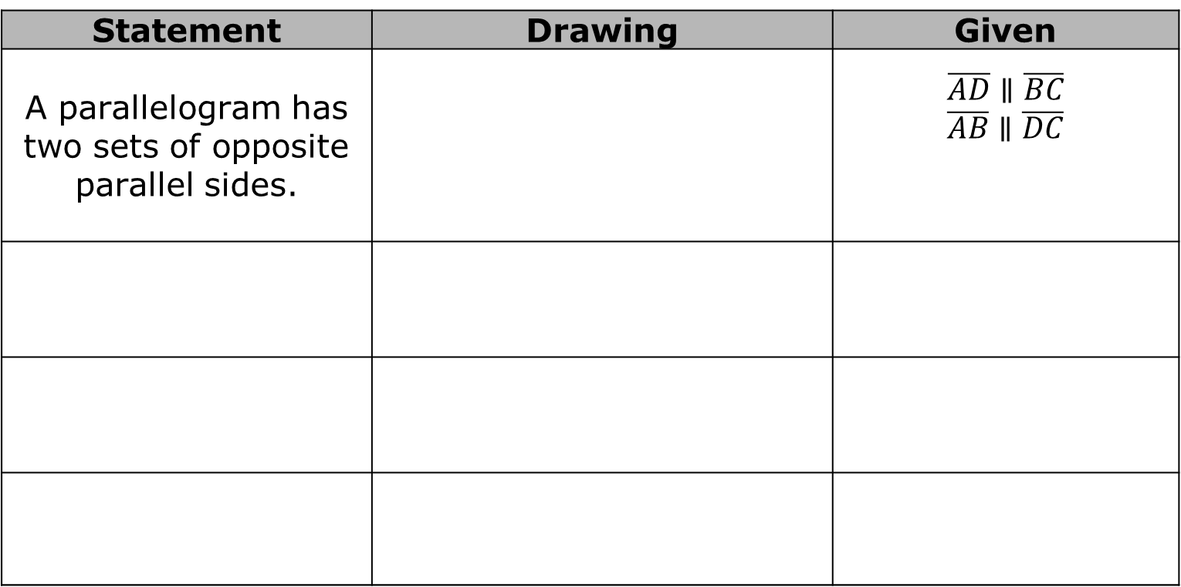
For each true statement in the previous problem, draw and name a parallelogram. Using the information in the statement, mark the diagram and write a mathematical statement. The first row has been completed.
Statement | Drawing | Given
A parallelogram has two sets of opposite parallel sides. |  | $$\overline{AD}∥\overline{BC}$$ $$\overline{AB}∥\overline{DC}$$
volume 2, pg. 10

Slide 17
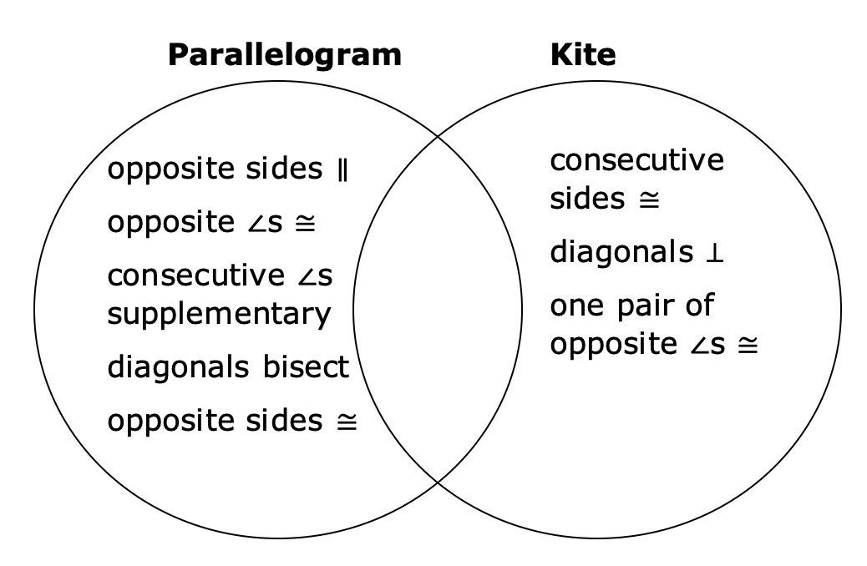
The Venn diagram shows the properties of a parallelogram and another quadrilateral called a kite. Discuss with your partner why a kite is not considered a parallelogram.
volume 2, pg. 10

Slide 18

Properties of Parallelograms
Opposite sides of a parallelogram are congruent.
Opposite angles of a parallelogram are congruent.
Consecutive interior angles of a parallelogram are supplementary.
The diagonals of a parallelogram bisect each other.
volume 2, pg. 10

Slide 19

Guided Instruction
volume 2, pg. 11

Slide 20
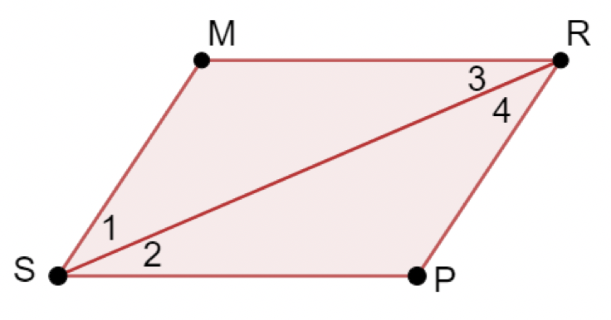

8.1.4 Guided Instruction: Proofs with Parallelograms
$MRPS$ is shown.
Given: $MRPS$is a parallelogram
Prove: $\overline{MR} ≅ \overline{SP}$ and $\overline{MS} ≅ \overline{RP}$
volume 2, pg. 11

Slide 21
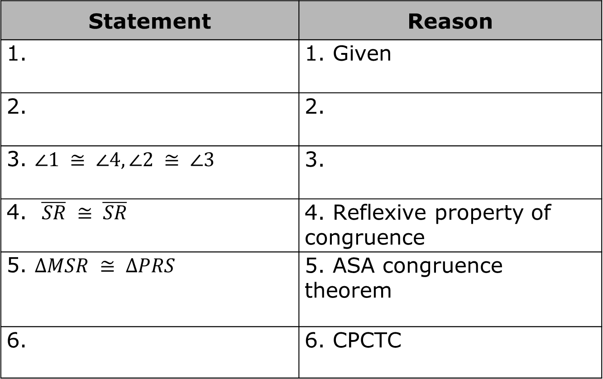
Complete the following two-column proof.
Statement | Reason
1. | 1. Given
2. | 2.
3. $∠1 ≅ ∠4, ∠2 ≅ ∠3$ | 3.
4. $\overline{SR} ≅ \overline{SR}$ | 4. Reflexive property of congruence
5. $∆MSR ≅ ∆PRS$ | 5. ASA congruence theorem
6. | 6. CPCTC
volume 2, pg. 11

Slide 22
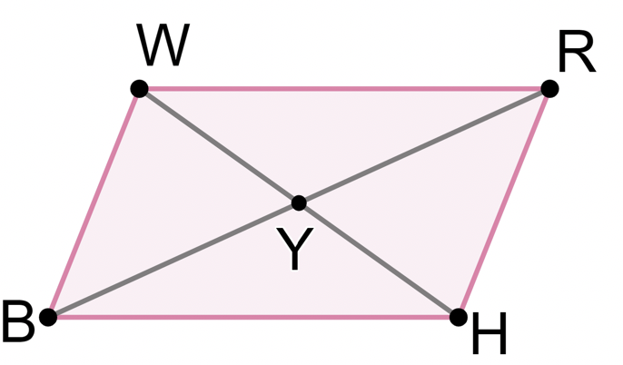

$WRHB$ with diagonals $\overline{WH}$and $\overline{BR}$ intersecting at $Y$ is shown.
Given: $WRHB$ is a parallelogram with diagonals $\overline{WH}$and $\overline{BR}$ intersecting at $Y$
Prove: $\overline{WH}$bisects $\overline{BR}$
$\overline{BR}$bisects $\overline{WH}$
volume 2, pg. 11

Slide 23
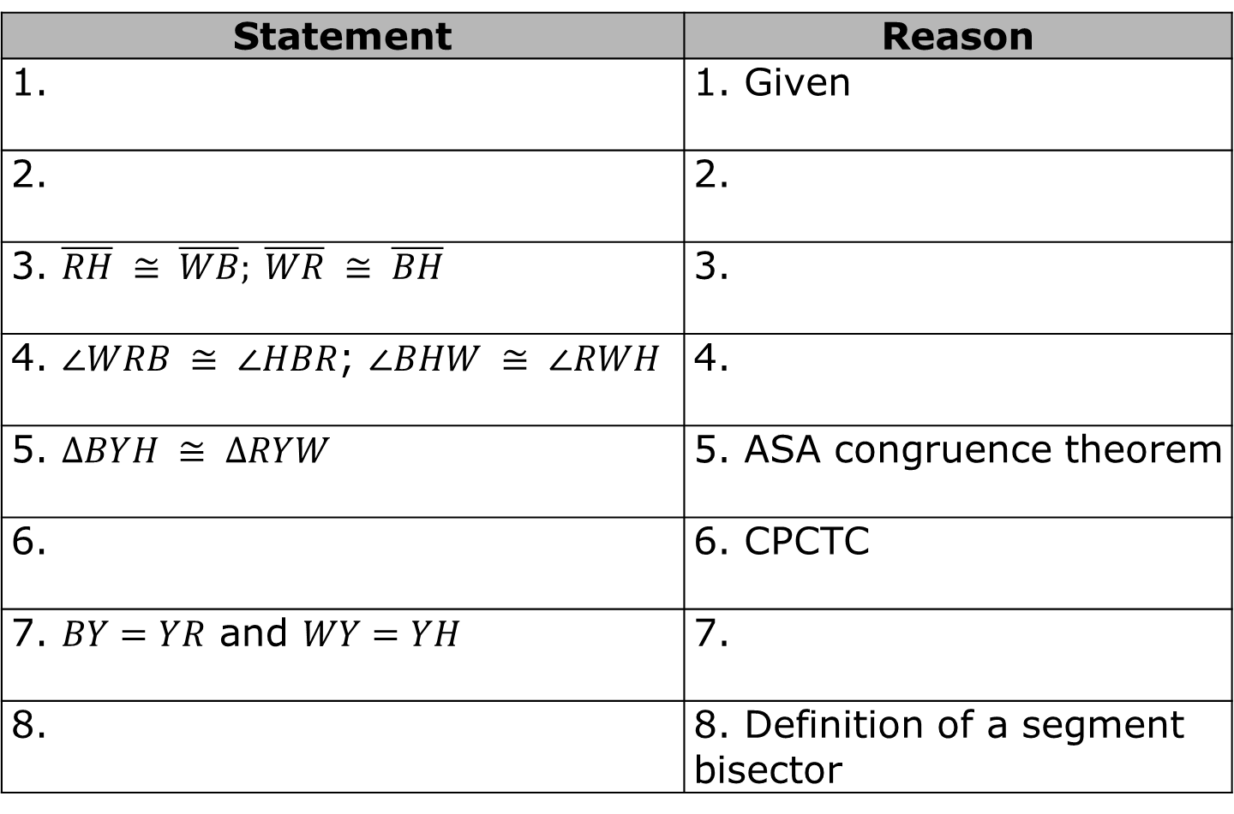
Complete the following two-column proof.
Statement | Reason
1. | 1. Given
2. | 2.
3. $\overline{RH} ≅ \overline{WB}; \overline{WR} ≅ \overline{BH}$ | 3.
4. $∠WRB ≅ ∠HBR$; $∠BHW ≅ ∠RWH$ | 4.
5. $∆BYH ≅ ∆RYW$ | 5. ASA congruence theorem
6. | 6. CPCTC
7. $BY=YR$ and $WY=YH$ | 7.
8. | 8. Definition of a segment bisector
volume 2, pg. 11

Slide 24
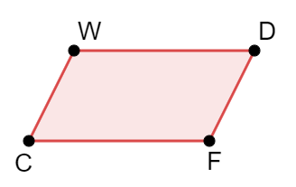

Complete the following flowchart proof. Statements go in the boxes and reasons go below the boxes.
Given: WDFC is a parallelogram.
Prove: $∠W$ is supplementary to $∠D$, $∠D$ is supplementary to $∠F$,
$∠F$ is supplementary to $∠C$, and$∠C$ is supplementary to $∠W$
volume 2, pg. 12

Slide 25
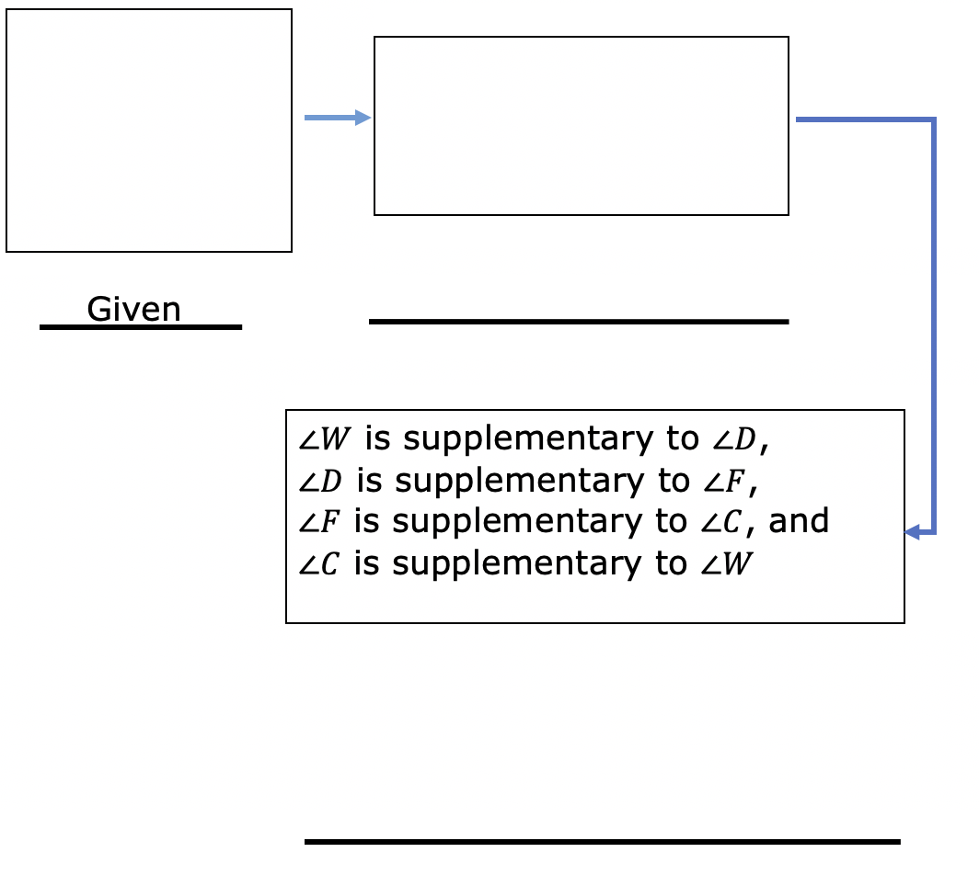
volume 2, pg. 12

Slide 26

Wrap-Up
volume 2, pg. 12

Slide 27
8.1.5 Wrap-Up: Cool Down
Write down one fact you knew about parallelograms before the lesson.
Write down one fact you learned about parallelograms during the lesson.
volume 2, pg. 12

